Slide 1
Determination of Forward and Futures Prices
Chapter 5

Slide 2
Consumption vs Investment Assets
Investment assets are assets held by many traders purely for investment purposes (Examples: gold, silver)
Consumption assets are assets held primarily for consumption (Examples: copper, oil)

Slide 3
Short Selling (Pages 108-109)
Short selling involves selling securities you do not own
Your broker borrows the securities from another client and sells them in the market in the usual way

Slide 4
Short Selling (continued)
At some stage you must buy the securities so they can be replaced in the account of the client
You must pay dividends and other benefits the owner of the securities receives
There may be a small fee for borrowing the securities

Slide 5
Example
You short 100 shares when the price is $100 and close out the short position three months later when the price is $90
During the three months a dividend of $3 per share is paid
What is your profit?
What would be your loss if you had bought 100 shares?

Slide 6
Notation for Valuing Futures and Forward Contracts
S₀: | Spot price today
F₀: | Futures or forward price today
T: | Time until delivery date
r: | Risk-free interest rate for maturity T

Slide 7
An Arbitrage Opportunity?
Suppose that:
  The spot price of a non-dividend-paying stock is $40
  The 3-month forward price is $43
  The 3-month US$ interest rate is 5% per annum
Is there an arbitrage opportunity?
Notes:
18

Slide 8
Another Arbitrage Opportunity?
Suppose that:
  The spot price of nondividend-paying stock is $40
  The 3-month forward price is US$39
  The 1-year US$ interest rate is 5% per annum
Is there an arbitrage opportunity?
Notes:
19

Slide 9
The Forward Price
If the spot price of an investment asset is S₀ and the futures price for a contract deliverable in T years is F₀, then
F₀ = S₀(1+r)^{T}
where r is the T-year risk-free rate of interest (measured with annual compounding)
In our examples, S₀ =40, T=0.25, and r=0.05 so that
F₀ = 40(1.05)^{0.25} =40.50
Notes:
20

Slide 10
When Interest Rates are Measured with Continuous Compounding
(Equation 5.1, page 111)
F₀ = S₀e^{rT}
This equation relates the forward price and the spot price for any investment asset that provides no income and has no storage costs

Slide 11
If Short Sales Are Not Possible..
Formula still works for an investment asset because investors who hold the asset will sell it and buy forward contracts when the forward price is too low

Slide 12
When an Investment Asset Provides a Known Dollar Income (Equation 5.2, page 114)
F₀ = (S₀ – I )e^{rT}
where I is the present value of the income during life of forward contract

Slide 13
When an Investment Asset Provides a Known Yield
(Equation 5.3, page 115)
F₀ = S₀ e^{(r–q )T}
where q is the average yield during the life of the contract (expressed with continuous compounding)

Slide 14
Valuing a Forward Contract
A forward contract is worth zero (except for bid-offer spread effects) when it is first negotiated
Later it may have a positive or negative value
Suppose that K is the delivery price and F₀ is the forward price for a contract that would be negotiated today

Slide 15
Valuing Forward Contracts
(Pages 115-118)
By considering the difference between a contract with delivery price K and a contract with delivery price F₀ we can show that:
  The value, f, of a long forward contract is
  (F₀−K)e^{−rT}
  the value of a short forward contract is
(K – F₀ )e^{–rT}

Slide 16
Forward vs Futures Prices
When the maturity and asset price are the same, forward and futures prices are usually assumed to be equal. (Eurodollar futures are an exception)
When interest rates are uncertain they are, in theory, slightly different:
  A strong positive correlation between interest rates and the asset price implies the futures price is slightly higher than the forward price
  A strong negative correlation implies the reverse

Slide 17
Stock Index (Page 119)
Can be viewed as an investment asset paying a dividend yield
The futures price and spot price relationship is therefore
F₀ = S₀ e^{(r–q )T}
where q is the dividend yield on the portfolio represented by the index during life of contract

Slide 18
Stock Index (continued)
For the formula to be true it is important that the index represent an investment asset
In other words, changes in the index must correspond to changes in the value of a tradable portfolio
The Nikkei index viewed as a dollar number does not represent an investment asset (See Business Snapshot 5.3, page 119)

Slide 19
Index Arbitrage
When F₀ > S₀e^{(r-q)T} an arbitrageur buys the stocks underlying the index and sells futures
When F₀ < S₀e^{(r-q)T} an arbitrageur buys futures and shorts or sells the stocks underlying the index

Slide 20
Index Arbitrage
(continued)
Index arbitrage involves simultaneous trades in futures and many different stocks
Very often a computer is used to generate the trades
Occasionally simultaneous trades are not possible and the theoretical no-arbitrage relationship between F₀ and S₀ does not hold (see Business Snapshot 5.4 on page 120)

Slide 21
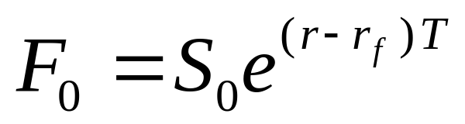
Futures and Forwards on Currencies (Pages 121-124)
A foreign currency is analogous to a security providing a yield
The yield is the foreign risk-free interest rate
It follows that if r_{f} is the foreign risk-free interest rate

Slide 22
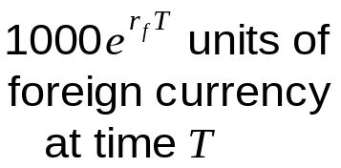
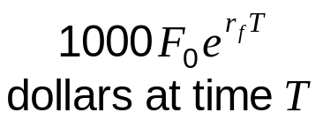
Explanation of the Relationship Between Spot and Forward (Figure 5.1, page 121)
1000 units of foreign currency (time zero)
1000S₀ dollars at time zero
1000S₀e^{rT}
dollars at time T

Slide 23
Consumption Assets: Storage is Negative Income
F₀ ≤ S₀ e^{(r+u )T}
where u is the storage cost per unit time as a percent of the asset value.
Alternatively,
F₀ ≤ (S₀+U )e^{rT}
where U is the present value of the storage costs.

Slide 24
The Cost of Carry (Page 127)
The cost of carry, c, is the storage cost plus the interest costs less the income earned
For an investment asset F₀ = S₀e^{cT}
For a consumption asset F₀ ≤ S₀e^{cT}
The convenience yield on the consumption asset, y, is defined so that F₀ = S₀ e^{(c–y )T}

Slide 25
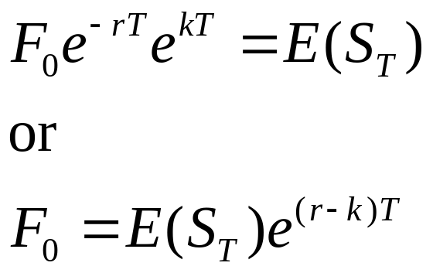
Futures Prices & Expected Future Spot Prices (Pages 128-130)
Suppose k is the expected return required by investors in an asset
We can invest F₀e^{–r T} at the risk-free rate and enter into a long futures contract to create a cash inflow of S_{T} at maturity
This shows that

Slide 26
Futures Prices & Future Spot Prices (continued)
No Systematic Risk | k = r | F₀ = E(S_{T})
Positive Systematic Risk | k > r | F₀ < E(S_{T})
Negative Systematic Risk | k < r | F₀ > E(S_{T})
Positive systematic risk: stock indices
Negative systematic risk: gold (at least for some periods)

